Slide 1

Automotive Technology:
A Systems Approach, 8e
Chapter 9: Automotive Engine Designs and Diagnosis
Rob Thompson and Jack Erjavec, Automotive Technology: A Systems Approach, 8th Edition. © 2025 Cengage. All Rights Reserved. May not be scanned, copied or duplicated, or posted to a publicly accessible website, in whole or in part.

Slide 2
Chapter Objectives (1 of 2)
09.01 Describe the types of modern engine construction.
09.02 Describe the various ways in which engines can be classified.
09.03 Explain what takes place during each stroke of the four-stroke cycle.
09.04 Define important engine measurements and performance characteristics, including bore and stroke, displacement, compression ratio, engine efficiency, torque, and horsepower.

Slide 3
Chapter Objectives (2 of 2)
09.05 Describe the basics of diesel, stratified, Atkinson, and Miller-cycle engine construction and operation.
09.06 Identify engines using ID and calibration tags.
09.07 Explain the tests used to evaluate the condition of an engine.
09.08 Evaluate the condition of an engine.
09.09 List and describe abnormal engine noises.

Slide 4
Introduction to Engines (1 of 2)
All automobile engines, both gasoline and diesel, are classified as internal combustion engines because the combustion or burning that creates energy takes place inside the engine.
The biggest part of the engine is the cylinder block which is a large casting of metal drilled with holes to allow for the passage of lubricants and coolant through the block and provide spaces for parts to move.
The main bores in the block are the cylinders, which are fitted with pistons.
The block houses or holds the major engine parts.
The cylinder head fits on top of the cylinder block to close off and seal the top of the cylinders.
The cylinder head contains all or most of the combustion chamber.
The combustion chamber is the area where the air–fuel mixture is compressed and burned.

Slide 5
Introduction to Engines (2 of 2)
The cylinder head also contains ports through which the air-fuel mixture enters and burned gases exit the cylinders and bores for the spark plugs.
The valve train opens and closes the intake and exhaust ports.
Movable valves open and close the ports.
A camshaft controls the movement of the valves.
Springs are used to help close the valves.
The up-and-down motion of the pistons must be converted to a rotary motion before it can drive the wheels of a vehicle.
To do this, the pistons are connected to a crankshaft by connecting rods.
The upper end of the connecting rod moves with the piston.
The lower end is attached to the crankshaft and moves in a circle.
The end of the crankshaft is connected to the flywheel or flexplate. Through the flywheel, the power from the engine is indirectly sent to the drive wheels.

Slide 6
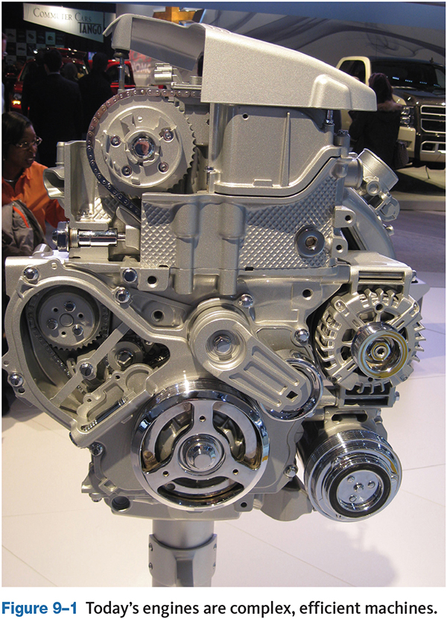
Engine Classifications
09.02 Describe the various ways in which engines can be classified
Today’s automotive engines can be classified in several ways depending on the following design features:
  Operational cycles
  Number of cylinders
  Cylinder arrangement
  Valve train type
  Ignition type
  Cooling systems
  Fuel type

Slide 7
Four-Stroke Cycle
09.03 Explain what takes place during each stroke of the four-stroke cycle.
A stroke is the full travel of the piston either up or down in a cylinder’s bore.
It takes two full revolutions of the crankshaft to complete the four-stroke cycle.
During one piston stroke, the crankshaft rotates 180 degrees.
The piston moves down by the pressure produced during combustion, but this moves the piston only enough to complete one stroke. In order to keep the engine running, the piston must travel through the other three strokes.
The inertia of a flywheel attached to the end of the crankshaft keeps the crankshaft rotating and allows the piston to complete the rest of the four-stroke cycle.
Top dead center (TDC) is when the piston is at its highest point in the cylinder.
Bottom dead center (BDC) is when the piston is at its lowest point in the cylinder.

Slide 8
Knowledge Check (1 of 2)
List three ways automotive engines can be classified.

Slide 9
Knowledge Check Answer (1 of 2)
Today’s automotive engines can be classified in several ways depending on the following design features:
  Operational cycles
  Number of cylinders
  Cylinder arrangement
  Valve train type
  Ignition type
  Cooling systems
  Fuel type

Slide 10
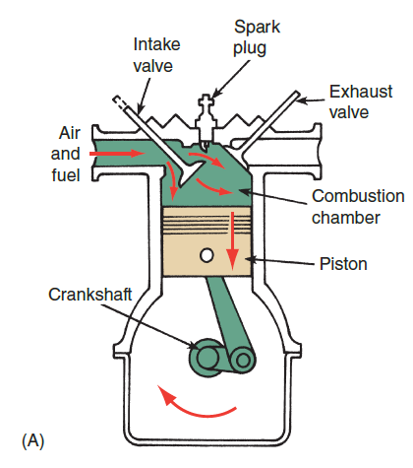
The Intake Stroke
As the piston moves away from top dead center (TDC), the intake valve opens.
The downward movement of the piston increases the volume of the cylinder above it, reducing the pressure in the cylinder.
This reduced pressure, commonly referred to as engine vacuum, causes the atmospheric pressure to push air through the open intake valve.
Air continues to enter the cylinder until the intake valve is closed.
In most engines, the intake valve closes after the piston has reached bottom dead center (BDC).

Slide 11
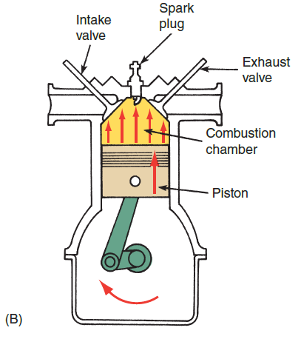
The Compression Stroke
The compression stroke begins as the piston starts to move from BDC.
With the intake valve closed, the air in the cylinder is trapped.
The upward movement of the piston compresses the air, thus heating it up.
The amount of pressure and heat formed by the compression stroke depends on the amount of air in the cylinder and the compression ratio of the engine.
In most modern engines, fuel is injected into the cylinder sometime during the compression stroke.

Slide 12
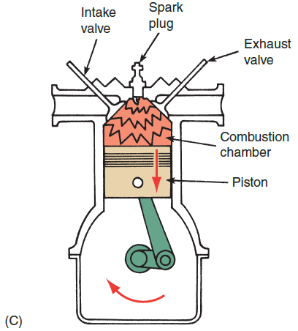
The Power Stroke
The power stroke, also called the expansion stroke, begins as the compressed fuel mixture is ignited.
With both valves closed, an electrical spark across the electrodes of a spark plug ignites the air–fuel mixture.
The burning mixture rapidly expands, creating a very high pressure against the top of the piston.
This drives the piston down toward BDC.
The downward movement of the piston is transmitted through the connecting rod to the crankshaft.

Slide 13
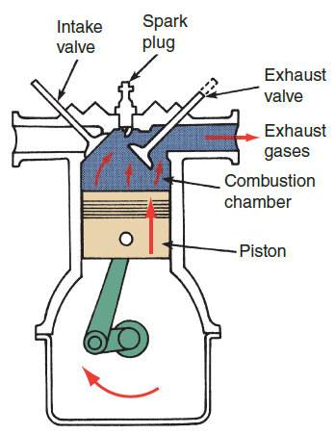
The Exhaust Stroke
The exhaust valve opens just before the piston reaches BDC on the power stroke.
Pressure within the cylinder causes the exhaust gas to rush past the open valve and into the exhaust system.
Movement of the piston from BDC pushes most of the remaining exhaust gas from the cylinder. As the piston nears TDC, the exhaust valve begins to close and the intake valve starts to open.
The exhaust stroke completes the four-stroke cycle and is followed by another intake stroke.

Slide 14
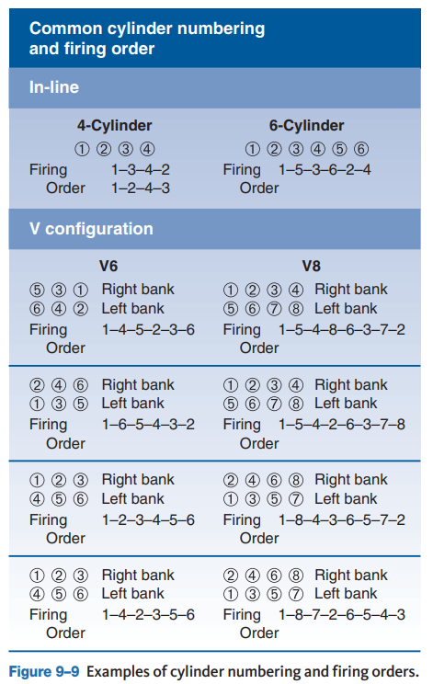
Firing Order
  An engine’s firing order states the sequence in which an engine’s pistons are on their power stroke and therefore the order in which the cylinders’ spark plugs fire.
  The firing order also indicates the position of the other pistons in an engine when a cylinder is firing.
  Not all engines have the same firing order, as it is determined by the design and manufacturer of the engine.

Slide 15
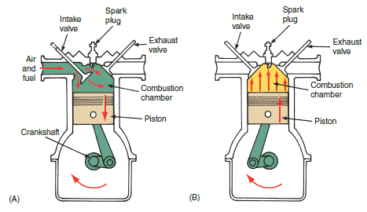
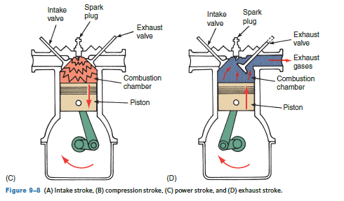
Discussion
Have a class discussion about the four-stroke cycle, discuss them in order and describe exactly what is happening in the cylinder and with the valves during each individual stroke.

Slide 16
Two-Stroke Gasoline Engine
In the past, several imported vehicles used two-stroke engines.
As the name implies, this engine requires only two strokes of the piston to complete all four
This is accomplished as follows:
  Movement of the piston from BDC to TDC completes both intake and compression.
  When the piston nears TDC, the compressed air–fuel mixture is ignited, causing an expansion of the gases. During this time, the intake and exhaust ports are closed.
  Expanding gases in the cylinder force the piston down, rotating the crankshaft.
  With the piston at BDC, the intake and exhaust ports are both open, allowing exhaust gases to leave the cylinder and air–fuel mixture to enter.
Although the two-stroke-cycle engine is simple in design and lightweight because it lacks a valve train, it has not been widely used in automobiles because it tends to be less fuel efficient and releases more pollutants than four-stroke engines.

Slide 17
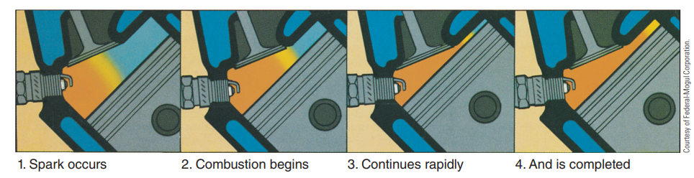
Combustion
Although many different things can affect the combustion in the engine’s cylinders, the ignition system has the responsibility for beginning and maintaining combustion.
When combustion does not occur in any of the cylinders, the engine will not run.
If combustion occurs in all but one or two cylinders, the engine may start and run but will run poorly.

Slide 18
Engine Measurement and Performance (1 of 4)
09.04 Define important engine measurements and performance characteristics, including bore and stroke, displacement, compression ratio, engine efficiency, torque, and horsepower.
The bore of a cylinder is simply its diameter measured in inches (in.) or millimeters (mm).
The stroke is the distance the piston travels between TDC and BDC.
The bore and stroke determine the displacement of the cylinders.
When the bore and stroke are of equal size, the engine is called a square engine. Engines that have a larger bore than stroke are called oversquare, and engines with a larger stroke than bore are referred to as being undersquare.
The crank throw is the distance from the crankshaft’s main bearing centerline to the connecting rod journal centerline. An engine’s stroke is twice the crank throw.

Slide 19
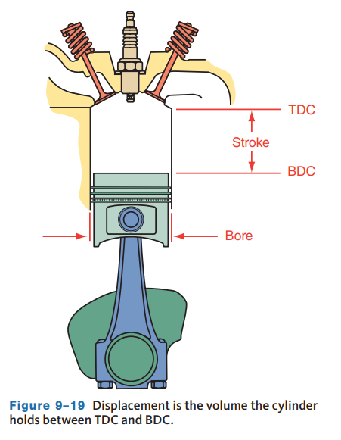
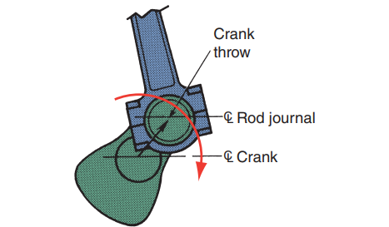
Engine Measurement and Performance (2 of 4)
A cylinder’s displacement is the volume of the cylinder when the piston is at BDC.
Engine displacement can be changed by changing the size of the bore and/or stroke of an engine.
The trend in recent years has been toward smaller displacement engines fitted with turbo- or superchargers to improve fuel economy.

Slide 20
Engine Measurement and Performance (3 of 4)
The compression ratio is a statement of how much the air–fuel mixture will be compressed during the compression stroke.
Worn piston rings, cylinder walls, and valves that do not seal properly can affect compression and cause engine performance concerns.
In some circumstances, compression ratio can increase due to carbon and dirt buildup in the cylinders This buildup of carbon will cause the compression ratio to increase because the volume at TDC is smaller.
The higher the compression ratio, the more power an engine theoretically can produce; however, the heat produced by the compression stroke also increases.
As the compression ratio increases, the octane rating of the gasoline should also be increased to prevent abnormal combustion.

Slide 21
Engine Measurement and Performance (4 of 4)
The expansion ratio is based on the length of the compression and power strokes.
For most engines, they are the same so the ratio is 1:1.
In Atkinson cycle and Miller cycle engines, the expansion ratio is greater than the compression ratio.
  This is achieved by holding the intake valve open into the compression stroke, well past its normal closing point allowing some of the air-fuel charge to exit the cylinder reduces pumping losses and reduces the compression ratio.
  Once the compressed air–fuel charge is ignited, the expansion takes place over the entire length of the piston’s downward stroke.
  The result is an expansion cycle that is longer than the compression cycle, increasing the efficiency of the engine.

Slide 22
Engine Efficiency (1 of 2)
One of the dominating trends in automotive design is increasing an engine’s efficiency.
Efficiency is simply a measure of the relationship between the amount of energy put into an engine and the amount of energy available from the engine. Other factors, or efficiencies, affect the overall efficiency of an engine.
Volumetric efficiency describes the engine’s ability to fill its cylinders with air and fuel.
If the engine’s cylinders can be filled during its intake stroke, the engine has a volumetric efficiency of 100 percent.
Typically, engines have a volumetric efficiency of 80 percent to 100 percent if they are not equipped with a turbo- or supercharger.
Turbochargers and superchargers force more air into the cylinders and therefore increase the volumetric efficiency of the engine.

Slide 23
Engine Efficiency (2 of 2)
Thermal efficiency is a measure of how much of the heat formed during combustion is available as power from the engine.
  Normally, only one-fourth of the heat is used to power the vehicle. The rest is lost to the surrounding air and engine parts and to the engine’s coolant.
  When less heat is lost, the engine is more efficient.
Mechanical efficiency is a measure of how much power is available once it leaves the engine compared to the amount of power that was exerted on the pistons during the power stroke.
  Power losses occur because of the friction generated by the moving parts. Minimizing friction increases mechanical efficiency.

Slide 24
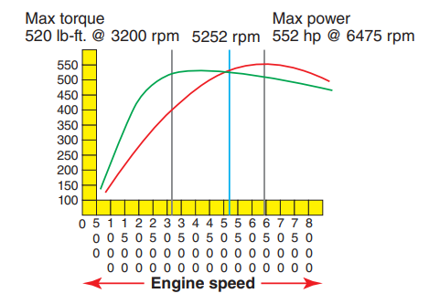
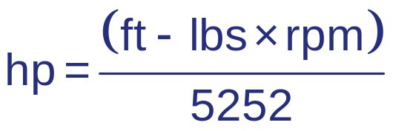
Torque versus Horsepower
Torque is a twisting or turning force.
Horsepower is the rate at which torque is produced.
When using foot-pounds (ft.-lbs) as units of torque, revolutions per minute (rpm) for engine speed, and horsepower (hp) for power, power can be calculated with the following formula:

Slide 25
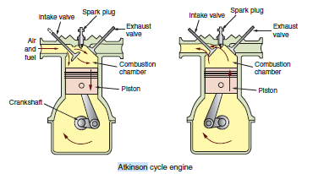
Atkinson Cycle Engines
09.05 Describe the basics of diesel, stratified, Atkinson, and Miller-cycle engine construction and operation
An Atkinson cycle engine is a four-stroke cycle engine in which the intake valve is held open longer than normal during the compression stroke.
As the piston is moving up, the mixture is being compressed, and some of it pushed back into the intake manifold.
As a result, the amount of mixture in the cylinder and the engine’s effective displacement and compression ratio are reduced.

Slide 26
Miller Cycle Engines
09.05 Describe the basics of diesel, stratified, Atkinson, and Miller-cycle engine construction and operation.
Miller Cycle Engines: An Atkinson cycle engine with forced induction (supercharging) is called a Miller cycle engine. The decrease of intake air and resulting low power is compensated for by the supercharger.
The supercharger forces air into the cylinder during the compression stroke. Keep in mind that the actual compression stroke in an Atkinson cycle engine does not begin until the intake valve closes.
The supercharger in a Miller cycle engine forces more air past the valve, and therefore, there is more air in the cylinder when the intake closes.

Slide 27
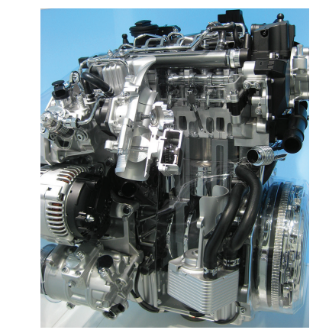
Diesel Engines (1 of 2)
Diesel engines were invented by Dr. Rudolph Diesel, a German engineer, and first marketed in 1897.
The diesel engine is now the dominant power plant in heavy-duty trucks, construction equipment, farm equipment, buses, marine, and some automotive applications.
The operation of a diesel engine is comparable to a gasoline engine. They also have a number of components in common, such as the crankshaft, pistons, valves, camshaft, and water and oil pumps.

Slide 28
Diesel Engines (2 of 2)
A diesel engine uses the heat produced by compressing air in the combustion chamber to ignite the fuel. The compression ratio of diesel engines can be three times (as high as 25:1) that of a gasoline engine, though newer engine technologies allow diesel engines to use lower compression ratios.
As intake air is compressed, its temperature rises to 1,300 °F to 1,650 °F (700 °C to 900 °C).
Just before the air is fully compressed, a fuel injector sprays a small amount of diesel fuel into the cylinder.
The high temperature of the compressed air instantly ignites the fuel. The combustion causes increased heat, and the resulting high pressure moves the piston down on its power stroke.

Slide 29
Homogeneous Charge Compression Ignition (HCCI) Engines
These are four-stroke cycle engines and rely on a combination of spark ignition and compression ignition technologies and can run as spark or compression ignited engines.
The term “Homogeneous Charge” means the fuel is thoroughly mixed with the intake air.
In the HCCI mode, the temperature of the mixture is greatly increased during the compression stroke, the air and fuel are mixed, and heat builds as the mixture is compressed.
This heat ignites the mixture without the need for a spark plug.
To develop the heat necessary for ignition, these engines have a very high-compression ratio and a very lean air/fuel mixture. To make all of this work, the mixture must get hot enough to “auto-ignite.”
When the mixture ignites, combustion immediately and simultaneously begins at several points within the mixture.

Slide 30
Knowledge Check (2 of 2)
  True or False? Horsepower is a twisting or turning force.

Slide 31
Knowledge Check Answer (2 of 2)
  True or False? Horsepower is a twisting or turning force.
  Answer: False. Torque is a twisting or turning force.
  Horsepower is the rate at which torque is produced.

Slide 32
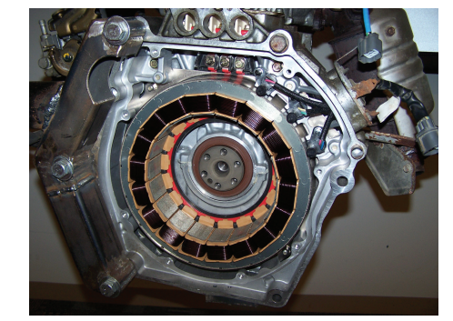
Hybrids
A hybrid vehicle has at least two different types of power or propulsion systems.
Today’s hybrid vehicles have an internal combustion engine and electric motor(s).
A hybrid’s electric motor is powered by batteries and/or ultracapacitors, which are recharged by a generator that is driven by the engine.
The electric motor may propel the vehicle by itself, assist the engine while it is propelling the vehicle, or act as a generator to charge the batteries.
The engines used in hybrids are specially designed for fuel economy and low emissions.
The engines tend to be small displacement engines that use VVT and the Atkinson cycle to provide low fuel consumption.

Slide 33
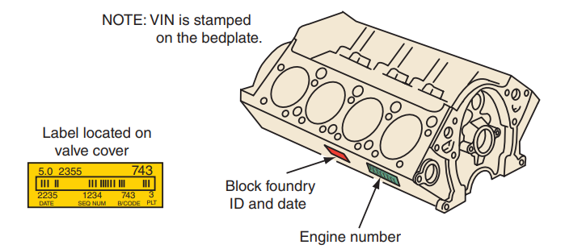
Engine Identification
09.06 Identify engines using ID and calibration tags.
Engine blocks often have a serial number stamped into them. An engine code is generally found beside the serial number.
The engine code will help you determine the correct specifications for that particular engine.
Many engines have ID tags or stickers attached to various places on the engine, such as the valve cover or oil pan. The tags include the displacement, assembly plant, model year, change level, engine code, and date of production.
Casting Numbers: Whenever an engine part such as an engine block or head is cast, a number is put into the mold to identify the casting and the date when the part was made.

Slide 34
Engine Diagnostics Relative Compression Test
09.07 Explain the tests used to evaluate the condition of an engine.
Be sure to follow the manufacturers’ procedures to prevent vehicle damage and personal injury.
Which tests and in what order they are performed will depend on the vehicle and the concern being diagnosed.
If the concern is related to poor or uneven engine performance and there are no DTCs stored, a technician may perform a relative compression test to make a quick assessment of an engine’s condition.
By measuring the cranking current with a lab scope, each cylinder’s draw on the starter motor and battery can be compared to the other cylinders.
Disable the fuel pump and crank the engine for 5 to 7 seconds. A cylinder with low compression will have less current draw than one with good compression.

Slide 35
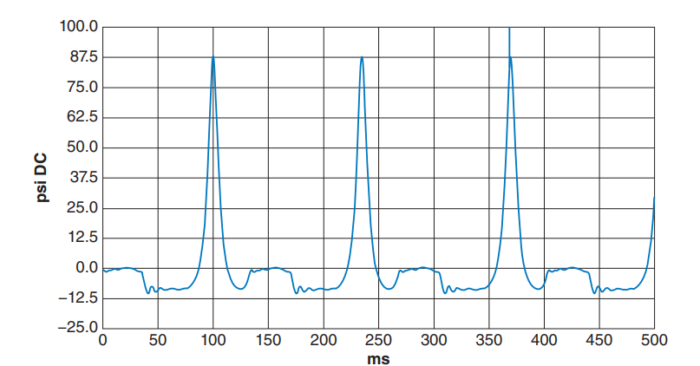
Running Compression Test
Engine problems such as worn camshaft lobes are not easily detected using a cranking compression test.
Using a standard compression test kit, remove the Schrader valve from the tester’s hose, or utilize a scope with pressure transducer.
Start the engine, the gauge will show both pressure and vacuum, and the needle will sweep up and down.
With the engine running, note the maximum pressure.
During running compression tests, cylinder pressures will likely be in the 70 to 80 psi range.

Slide 36
Cylinder Leakage Test
If a compression test reading is low, a cylinder leakage test should be performed.
The cylinder leakage tester applies compressed air to a cylinder through its spark plug hole and has a gauge which registers the percentage of leakage between 0% and 100%.
The amount and location of the air that escapes gives a good idea of the engine’s condition and can pinpoint where compression is lost.
  A zero reading means there is no leakage in the cylinder.
  Readings of 100 percent indicate that the cylinder will not hold any pressure.
  Any reading that is more than 0 percent indicates there is some leakage.
Most engines, even new ones, experience some leakage around the rings, as up to 20 percent is considered acceptable.
The location of dominant compression leaks can be found by listening or feeling around various parts of the engine.

Slide 37
Verifying Valve Timing (1 of 2)
An engine that does not run properly, or possibly at all, may have incorrect valve timing.
As timing belts, chains, tensioners, and guides wear, the belt or chain may develop enough slack to jump time, meaning the crank and cam are no longer synchronized correctly.
To check cam timing with a scope:
  Connect one channel to the crankshaft position (CKP) sensor signal and a second channel to the camshaft position (CMP) sensor.
  Crank or start the engine and pause the signal patterns on the screen.
  To determine if the correlation is correct, you may need to compare your pattern to a known good pattern.
  These may be available from the vehicle manufacturer or you may find an example online.

Slide 38
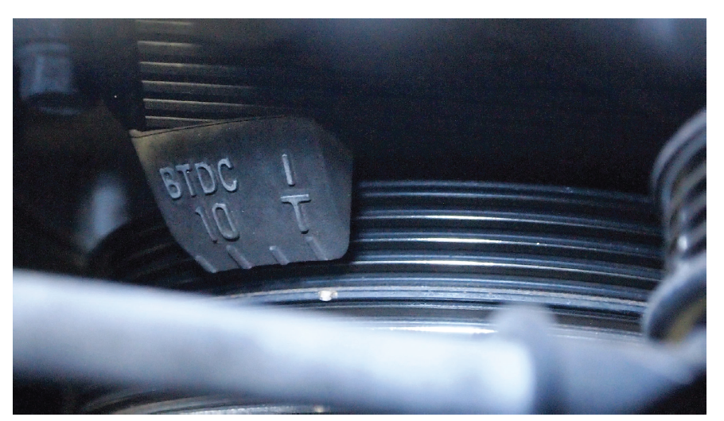
Verifying Valve Timing (2 of 2)
To physically check the timing, rotate the crankshaft to number 1 TDC and align the crank timing marks.
Remove the upper timing cover or valve cover as necessary to expose the timing marks on the camshaft(s).
Refer to the manufacturer’s service information to see how the marks should appear. If the marks all align properly, the valve timing is correct.
Incorrect valve timing can cause drivability concerns such as a rough idle, misfires, a lack of power, excessive emissions, and MIL.

Slide 39
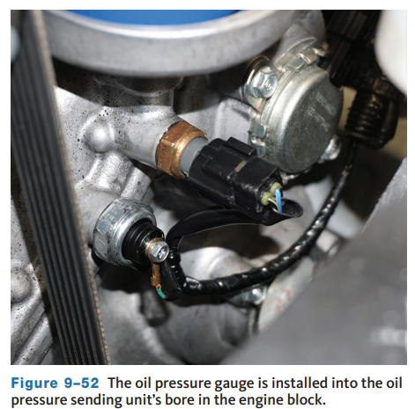
Oil Pressure Testing
An oil pressure test is used to determine the wear of an engine’s parts.
The test is performed with an oil pressure gauge, which measures the pressure of the oil as it circulates through the engine.
Excessive clearances, most often caused by wear between a shaft and its bearings, will cause a decrease in oil pressure.
Excessive bearing clearances are not the only possible causes for low oil pressure readings; others are oil pump-related problems, a plugged oil pickup screen, weak or broken oil pressure relief valve, low oil level, contaminated oil, or low oil viscosity.
Higher than normal pressures can be caused by too much oil, cold oil, high oil viscosity, restricted oil passages, or a faulty pressure regulator.

Slide 40
Evaluating the Engine’s Condition (1 of 3)
09.08 Evaluate the condition of an engine.
Once the compression, cylinder leakage, vacuum, and power balance tests are performed, further testing can be done to evaluate the engine’s condition.
For example, an engine with good relative compression but high cylinder leakage past the rings is typical of a high-mileage worn engine.
This engine would have these symptoms:
  Excessive blowby, lack of power
  Poor performance
  Reduced fuel economy
If comparable compression and leakage test results are found on an engine with comparatively low mileage, the problem is probably stuck piston rings that are not expanding properly.
If this is the case, try treating the engine with a combustion chamber cleaner.

Slide 41
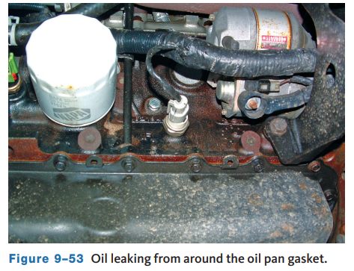
Evaluating the Engine’s Condition (2 of 3)
Fluid Leaks
  When inspecting the engine, check it for leaks.
  Carefully look at the top and sides of the engine and note any we residue that may be present.
  Sometimes, road dirt will mix with the leaking fluid and create a heavy coating.
  Look under the vehicle for leaks or drips.
  All leaks should be corrected.

Slide 42
Evaluating the Engine’s Condition (3 of 3)
Examining and interpreting the vehicle’s exhaust can give clues of potential engine problems.
On a cold day after the vehicle has been idling for a while, it is normal for white smoke to come out of the tailpipe which is steam from condensation being heated.
However, the steam should stop once the engine reaches normal operating temperature. If it does not, a problem is indicated.
The color of the exhaust is used to diagnose engine concerns.
Engine Type | Visible Sign | Diagnosis | Probable Causes
Gasoline | Gray or black smoke | Incomplete combustion or excessively rich A/F mixture | Clogged air filter Faulty fuel injection system Faulty emission control system Ignition problem Restricted intake manifold
Diesel | Gray or black smoke | Incomplete combustion | Clogged air filter Faulty fuel injection system Faulty emission control system Wrong grade of fuel Engine overheating
Gasoline and diesel | Blue smoke | Burning engine oil | Oil leaking into combustion chamber Worn piston rings, cylinder walls, valve guides, or valve stem seals Oil level too high
Gasoline | White smoke | Coolant/water is burning in the combustion chamber | Leaking head gasket Cracked cylinder head or block
Diesel | White smoke | Fuel is not burning | Faulty injection system Engine overheating
Figure 9–55 Exhaust analysis.

Slide 43
Noise and Vibration Diagnosis (1 of 4)
09.09 List and describe abnormal engine noises.
An engine malfunction is likely to reveal itself first as an unusual noise and increased vibration.
This can happen well before the problem affects the driveability of the vehicle.
Problems such as loose pistons, badly worn rings or ring lands, loose piston pins, worn main bearings and connecting rod bearings, loose vibration damper or flywheel, cracked flexplates, and worn or loose valve train components all produce telltale sounds.
Excessive engine vibration can also be linked to unusual noises.
Worn powertrain mounts can cause an engine to vibrate and move more than normal.
As mounts age, the dampening components can harden, allowing excessive vibration to transmit through the mount and to the body of the vehicle.

Slide 44
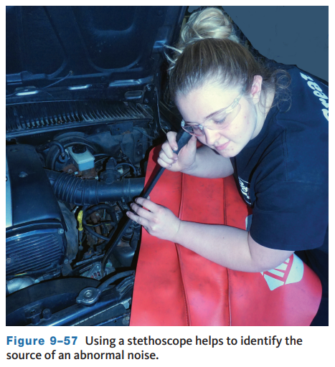
Noise and Vibration Diagnosis (2 of 4)
Using a Stethoscope
  A stethoscope is very helpful in locating engine noise by amplifying the sound waves.
  Use the metal prod to trace the sound until it reaches its maximum intensity.
  Once the precise location has been discovered, the sound can be better evaluated.
  If a stethoscope is not available, a long screwdriver or prybar may also be used.

Slide 45
Noise and Vibration Diagnosis (3 of 4)
An important point to keep in mind is that insufficient lubrication is the most common cause of engine noise.
For this reason, always check the fluid levels first before moving on to other areas of the vehicle.
Some noises are more pronounced on a cold engine because clearances are greater when parts are not expanded by heat. Remember that aluminum and iron expand at different rates as temperatures rise.
For example, a knock that disappears as the engine warms. An aluminum piston expands more than the iron block, allowing the piston to fit more closely as engine temperature rises.
Also keep in mind that loose accessories, cracked flexplates, damaged harmonic balancers, loose bolts, bad belts, broken mechanical fuel pump springs, and other noninternal engine problems can be mistaken for more serious internal engine problems.

Slide 46
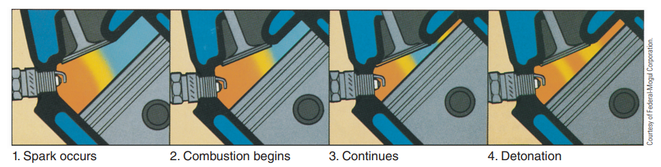
Noise and Vibration Diagnosis (4 of 4)
Noises caused by detonation and preignition are caused by abnormal engine combustion.
Detonation knock or ping is a noise most noticeable during acceleration with the engine under load and running at normal temperature.
Detonation occurs when part of the air–fuel mixture begins to ignite on its own. This results in the collision of two flame fronts.

Slide 47
Chapter Reflection
Please take a moment to compare your perception of the automotive industry before and after you studied this chapter. Then respond to the following questions in one or two paragraphs. Use 150–200 words in your reflection.
Did anything in this chapter change your thinking about automotive engine designs?
Considering all you have learned, do you feel you are able to apply basic engine diagnosis theories?

